Slide 1

Mechanics
of Escapement Goal Analysis in Alaska
Stock-Recruit Analysis:
Ricker Stock-Recruit Relationship
Classic Ricker Estimation
Lab: Estimation and Uncertainty
Problems and Special Issues
Bayesian State-Space Models
1
Notes:
1
So without getting into Ricker vs. BH vs. other models, we’ve seen some reasons Ricker S-R may be a useful tool.

Slide 2
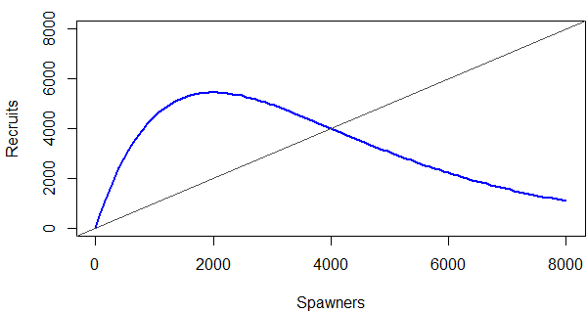
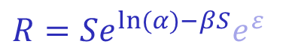
Ricker Relationship: Parameters
R
$$R=Se^{\ln{(}α)−βS}e^{ε}$$
S
At its most basic, the Ricker curve goes up, then comes down again
α: How steeply it goes up (Recruits/spawner at small S)
β: How quickly it comes down (Strength of density-dependence)
2
SRA - Ricker S-R Relationship - parameters (1)
Notes:
2
This may feel like repetition, but it’s worth spending some time reviewing how the Ricker parameters work, and how the Ricker relationship functions.
The biological interpretation of parameters is obviously more important, but here’s a geometric one as well if it helps.
Describing the Ricker curve in purely pictographic terms, R vs S goes up relatively steeply, then comes down again
alpha: how steeply it goes up
beta: how quickly it gets sucked back down
The diagonal is what we call the replacement line, where we get 1 recruit back for every 1 spawner we put in.
Notice:
Get more recruits back per spawner at low density (curve is above the replacement line)
Get fewer recruits back per spawner at high density (curve is below the replacement line)
here’s the equation for Recruits vs Spawners

Slide 3
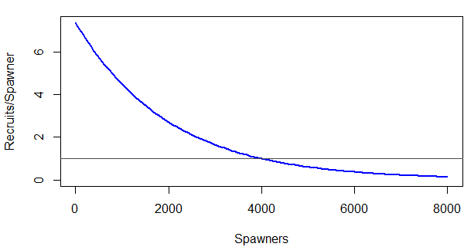
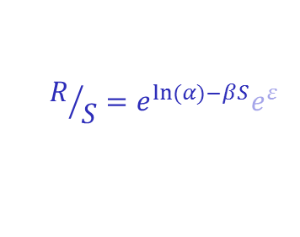
Ricker Relationship: Parameters
R
$$R=Se^{\ln{(}α)−βS}e^{ε}$$
$$R/S=e^{\ln{(}α)−βS}e^{ε}$$
R/S
S
Good way to think of the relationship is in terms of Recruits per Spawner
α: Recruits/spawner at small S
β: How quickly it comes down (Strength of density-dependence)
3
SRA - Ricker S-R Relationship - parameters (2)
Notes:
3
And actually, better way to understand - think in terms of Recruits per Spawner R/S
Starts off at a relatively large value, then always decreases
Notice that the y-intercept of this curve is alpha: defined as R/S as S->0
And notice that R crosses the replacement line where R/S crosses 1. Makes sense, right?

Slide 4
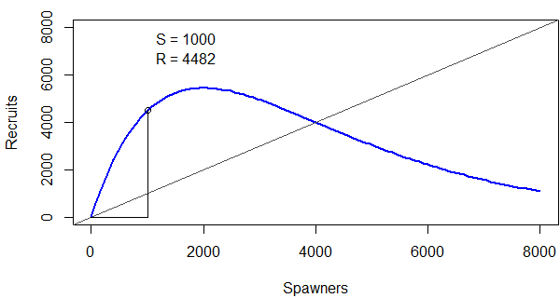
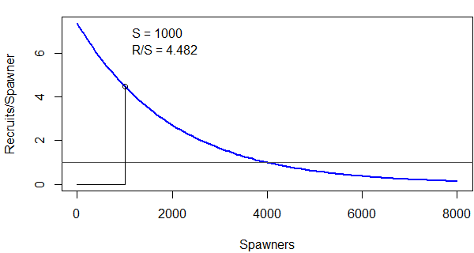
Ricker Relationship: Parameters
R
$$R=Se^{\ln{(}α)−βS}e^{ε}$$
$$R/S=e^{\ln{(}α)−βS}e^{ε}$$
R/S
S
Good way to think of the relationship is in terms of Recruits per Spawner
α: Recruits/spawner at small S
β: How quickly it comes down (Strength of density-dependence)
4
SRA - Ricker S-R Relationship - parameters (3)
Notes:
4
Let’s pick on a few values of S to illustrate the relationship between the two curves…

Slide 5
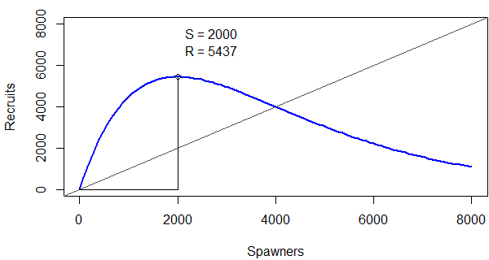
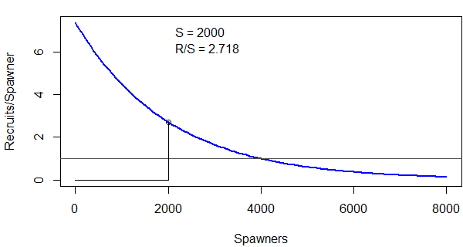
Ricker Relationship: Parameters
R
$$R=Se^{\ln{(}α)−βS}e^{ε}$$
$$R/S=e^{\ln{(}α)−βS}e^{ε}$$
R/S
S
Good way to think of the relationship is in terms of Recruits per Spawner
α: Recruits/spawner at small S
β: How quickly it comes down (Strength of density-dependence)
5
SRA - Ricker S-R Relationship - parameters (4)
Notes:
5
…and another one…

Slide 6
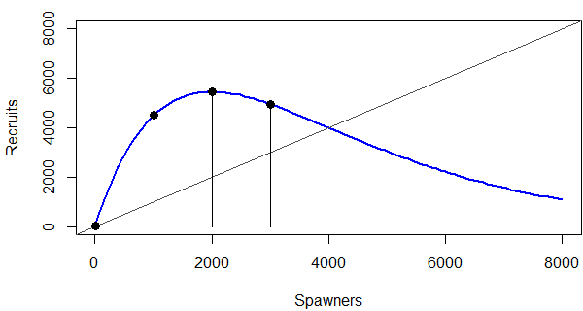
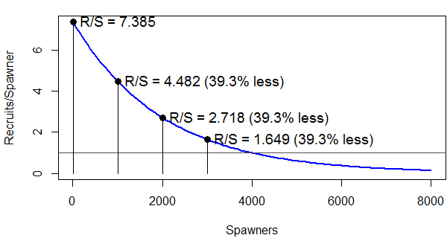
Ricker Relationship: Parameters
R
$$R=Se^{\ln{(}α)−βS}e^{ε}$$
$$R/S=e^{\ln{(}α)−βS}e^{ε}$$
R/S
S
Good way to think of the relationship is in terms of Recruits per Spawner
α: Recruits/spawner at small S
β: How quickly it comes down (Strength of density-dependence)
6
SRA - Ricker S-R Relationship - parameters (5)
Notes:
6
And this is probably an ancillary point, but notice that effect of additional S is multiplicative on R/S
R/S is cut by the same ratio if you go from 0-1000 spawners as 1000-2000, 2000-3000…
each X number of additional spawners decreases R/S by a constant percentage

Slide 7
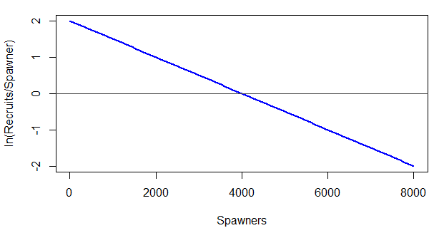
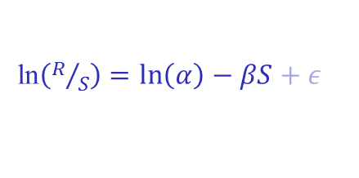

Ricker Relationship: Parameters
R
$$R=Se^{\ln{(}α)−βS}e^{ε}$$
$$R/S=e^{\ln{(}α)−βS}e^{ε}$$
Aside:
Log-transform often makes sense when variation naturally occurs on the multiplicative scale
If it makes sense to think in terms of “half as much”… “twice as much” … etc.
Log transform re-expresses this on additive scale
R/S
ln(R/S)
ln$\left(R/S\right)=\ln\left(α\right)−βS+ε$
7
SRA - Ricker S-R Relationship - parameters (6)
S
7
Notes:
7
And it turns out that taking the log of R/S linearizes the relationship
Because log re-expresses multiplicative-scale effects on additive scale!
Also notice that R vs S crosses the replacement line where R/S=1 and where log(R/S)=0
[click]
Statistical aside:
Remember how the log re-expresses multiplicative-scale effects on the additive scale…
if it ever makes intuitive sense to think in terms of effects being multiplicative, maybe a good candidate for log-transform

Slide 8

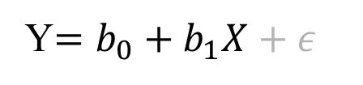
Ricker Relationship: Parameters
R
$$R=Se^{\ln{(}α)−βS}e^{ε}$$
$$R/S=e^{\ln{(}α)−βS}e^{ε}$$
R/S
ln$\left(R/S\right)=\ln\left(α\right)−βS+ε$
Y$=b_{0}+b_{1}X+ε$
ln(R/S)
“Typical” linear regression form
8
SRA - Ricker S-R Relationship - parameters (7)
S
8
Notes:
8
And it so happens that parameterizing in terms of log(R/S) gives Ricker the same form as a simple linear regression!
Response variable
Predictor variable
Slope & intercept (hang onto these ideas)
Additive error

Slide 9
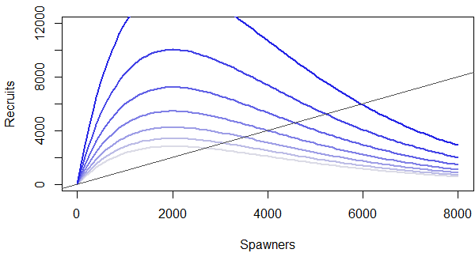
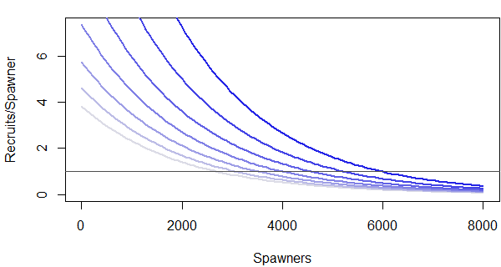
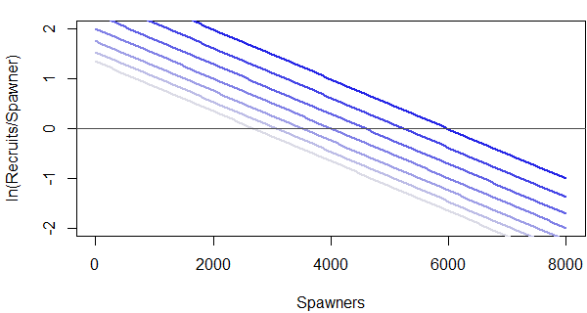


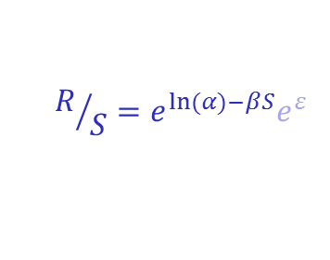
Ricker Relationship: Parameters
Increasing α
β held constant
R
$$R=Se^{\ln{(}α)−βS}e^{ε}$$
Increasing α
β held constant
$$R/S=e^{\ln{(}α)−βS}e^{ε}$$
R/S
Increasing α
β held constant
ln$\left(R/S\right)=\ln\left(α\right)−βS+ε$
ln(R/S)
9
S
9
SRA - Ricker S-R Relationship - parameters (8)
Notes:
9
And I’m definitely guilty of repeating material that Adam has already covered, but it’s worth making sure we all understand what the parameters do.
Again, what’s the biological interpretation of alpha? (R/S at low density)
To illustrate what it does, this is the effect of changing it on all three scales: Recruits vs Spawners, then R/S, then log(R/S)
If alpha large,
-trajectory steep, many recruits per spawner at origin,
-R climbs high above replacement line before succumbing to density effects,
-productivity and yield are generally high
If alpha small,
-not many R per S to begin with, therefore:
-R never gets very high
-yield low
Interesting to note: location of peak of R vs S curve doesn’t change with alpha, only beta
What’s beta? (strength of density dependence)
This means that the value of S that maximizes R doesn’t depend on productivity, only density dependence

Slide 10
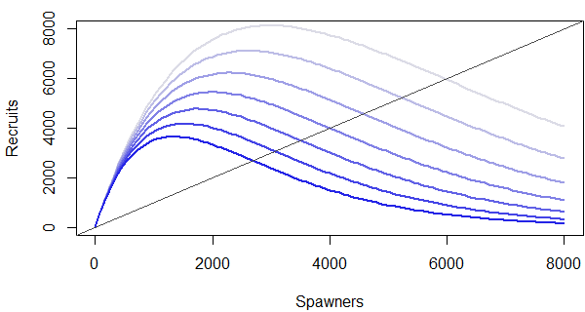
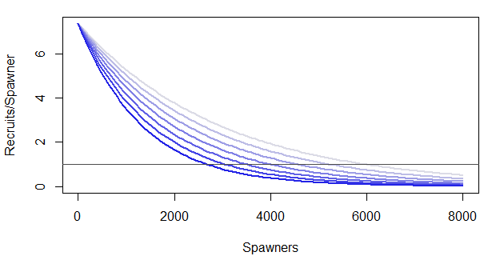
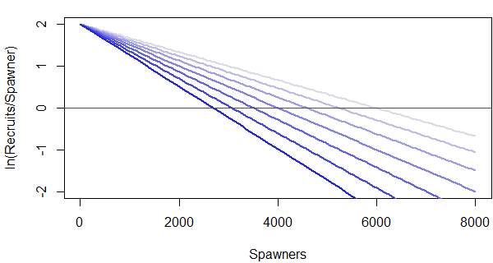
Ricker Relationship: Parameters
Increasing β
α held constant
R
$$R=Se^{\ln{(}α)−βS}e^{ε}$$
Increasing β
α held constant
$$R/S=e^{\ln{(}α)−βS}e^{ε}$$
R/S
ln$\left(R/S\right)=\ln\left(α\right)−βS+ε$
Increasing β
α held constant
ln(R/S)
10
S
10
SRA - Ricker S-R Relationship - parameters (9)
Notes:
10
Effect of changing slope term (beta)
Notice all R vs S curves have same trajectory at origin – why? (same alpha)
Also notice all R vs S curves have similar “shape” – think of beta as what scales the curve up or down (inflates/deflates?)
large beta, R/S falls off quickly, reaches equilibrium at small population sizes
small beta, R/S falls off more slowly, R peaks at higher S, equilibrium is larger
if alpha determines shape of the curve and the productivity,
beta determines the size of the curve and the size of the population

Slide 11
Maximum Sustained Yield
R
MSY
S_{MSY}
S
11
SRA - Ricker S-R Relationship - MSY
Notes:
11
alpha and beta define curve, but generally surplus production is where the rubber meets the road for us
-MSY- Maximum Sustained Yield (max surplus production, above repl line) and (even more important)
-S.msy- value of S that results in MSY
Remember: surplus production (above repl line) = “extra” R you get back, for S that were put in
Things to notice:
-Ricker: < halfway between 0 and Seq (equilibrium)
-we can convince ourselves that S.msy more sensitive to beta than alpha
-Yield flat near Smsy, that is can move away and still get high yields

Slide 12
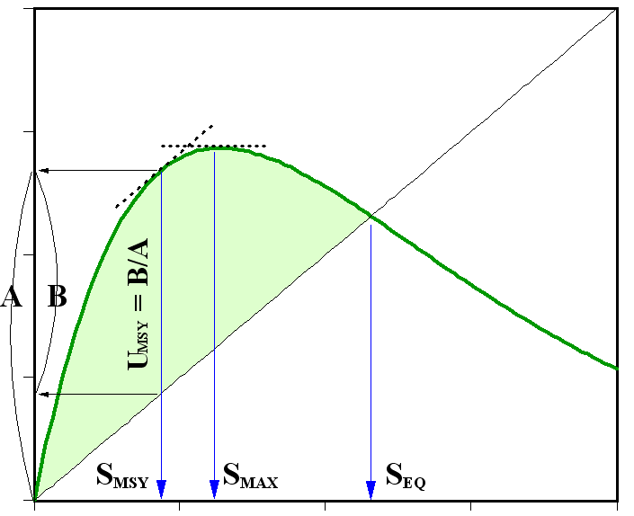
In an ideal world (if α and β were known), reference points would be derived from curve
where
12
SRA – Ricker S-R Relationship – Reference points
Notes:
12
Now, fans of calculus will note that since Ricker relationship is a mathematically defined curve, it should be possible to derive reference points by smacking it over the head with some math.
(that is, mathematically determine locations & magnitudes of features of the curve)
This would be true if alpha and beta were known without error.

Slide 13
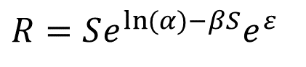
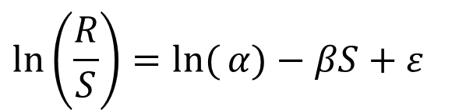
Except α and β are not known without error! Estimating α and β: Simple Linear Regression Model
Karluk Chinook
20,000
16,000
12,000
R
8,000
$$R=Se^{\ln{(}α)−βS}e^{ε}$$
4,000
can be expressed as…
0
0
4,000
8,000
12,000
16,000
S
intercept
1.2
(negative) slope
0.8
$$\ln\left(\frac{R}{S}\right)=\ln{(}α)−βS+ε$$
ln(R/S)
0.4
process
error
0.0
0
5,000
10,000
15,000
response
variable
predictor
variable
-0.4
13
S
SRA - Classic Ricker Estimation – Regression model
Notes:
13
But we live in the real world, and have to estimate alpha and beta first. (That’s why we need data!)
And it turns out (as we saw before) that using the ln(R/S) parameterization means we can use regression-type methods:
ln(R/S) = response variable
S = predictor variable
log alpha = intercept
negative beta = slope
and process error (additive on the log scale)

Slide 14
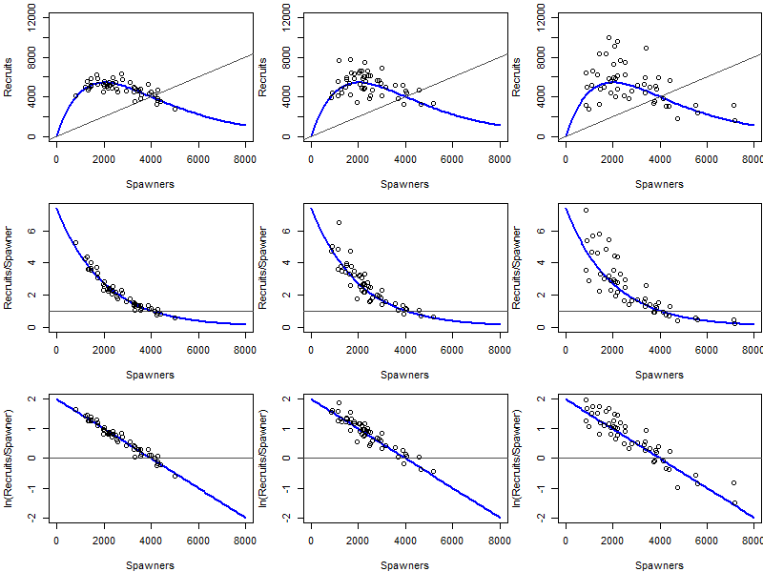
Process error:
difference between reality and expected by model
Biological
Environmental
etc...
σ = 0.1
σ = 0.2
σ = 0.3
R
R/S
ln(R/S)
S
S
S
14
SRA - Classic Ricker Estimation – Process error
Notes:
14
And it’s worth talking a little about process error.
If we knew S & R without error and data didn’t fall perfectly on the curve, is there something wrong with our data?
No, process error is different from measurement error
Deviations from deterministic relationship
think of it as why “this year” is different from the others (Big chum run, cooler ocean temp, lots of bugs…)

Slide 15
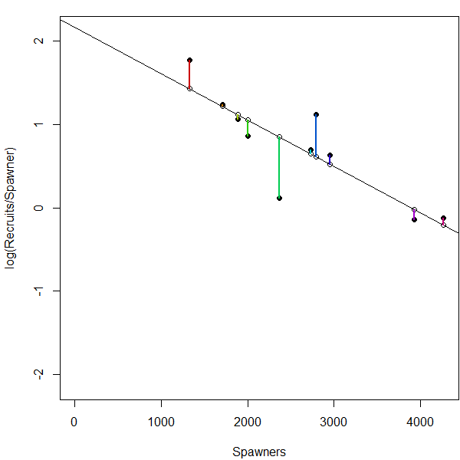
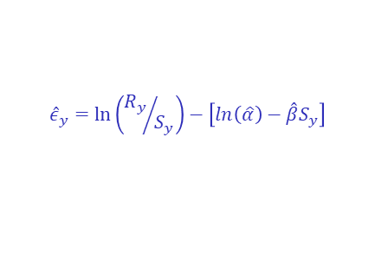
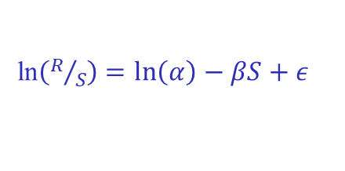
Expressing uncertainty in estimation of α and β:
Bootstrapping regression residuals
Unpacking this…
Residuals: difference between data and model fit
For now,
So…
ln$\left(R/S\right)=\ln\left(α\right)−βS+ε$
ln(R/S)
estimated values
$${\hat{ε}}_{y}=\ln\left({R_{y}}/{S_{y}}\right)−\left[ln\left(\hat{α}\right)−\hat{β}S_{y}\right]$$
data
model fit
Bootstrapping: resampling data (in this case, regression residuals) with replacement
S
15
SRA - Classic Ricker Estimation – Bootstrapping (1)
Notes:
15
So, we can estimate alpha and beta using regression, but need to express our uncertainty in estimation.
One technique that gets used for that is bootstrapping regression residuals.
And by “regression residuals residuals”, what we’re talking about is the differences between actual data and model fit
In this figure, the regression line represents the model fit,
And the residuals are the vertical rainbow-colored lines (different colors to keep track of them) - and remember, we’re working on the ln(R/S) scale
And bootstrapping in general means resampling data with replacement
So in this case, we’re resampling regression residuals with replacement

Slide 16

Expressing uncertainty in estimation of α and β:
Bootstrapping regression residuals
ln$\left(R/S\right)=\ln\left(α\right)−βS+ε$
Isolates random component of the model (deviations from expected)
Biological, environmental, etc…
Assumes all these deviations are exchangeable
Reshuffling gives other “plausible realities”
ln(R/S)
S
16
SRA - Classic Ricker Estimation – Bootstrapping (2)
Notes:
16
So back in context of what we’re doing, working with the residuals has the effect of isolating the random component of the model.
Can think of “deviations from expected” as the data we use for expressing variability!
remember, deviations are effects of real-world processes, some of which we don’t know about
Reshuffling deviations assumes they’re mathematically exchangeable.
Are they? (answer: no, not really, and we’ll talk about that)
It’s likely that brood years that are closer together in time will be more similar than brood years that are spaced farther apart

Slide 17
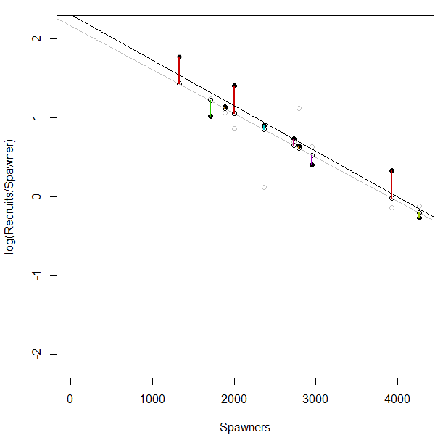
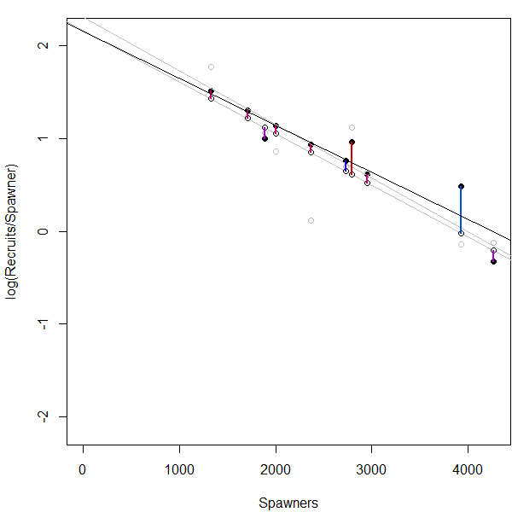
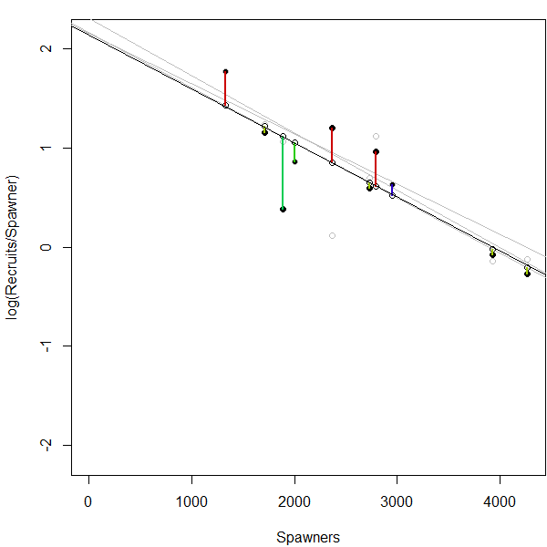
Expressing uncertainty in estimation of α and β:
Bootstrapping regression residuals
ln$\left(R/S\right)=\ln\left(α\right)−βS+ε$
Mechanistically, the process is
Fit ln(R/S) ~ S using regression
Pull out fitted values and residuals
Then for some large (≥500) number of times…
Resample residuals with replacement, add to fitted values
Do a new regression
Store coefficient estimates
Intercept estimates ln(α)
Slope estimates -β
ln(R/S)
S
17
SRA - Classic Ricker Estimation – Bootstrapping (3)
Notes:
17
But for now, here’s the process.
[click]
Which we iterate again…
[click]
Note that the residuals change locations and/or appear multiple times.

Slide 18
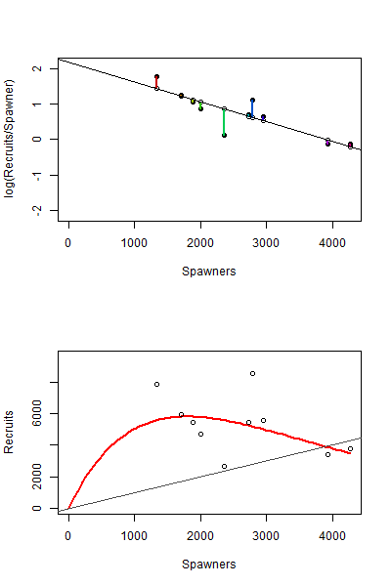
Expressing uncertainty in estimation of α and β:
Bootstrapping regression residuals
ln$\left(R/S\right)=\ln\left(α\right)−βS+ε$
ln(R/S)
Mechanistically, the process is
Fit ln(R/S) ~ S using regression
Pull out fitted values and residuals
Then for some large (≥500) number of times…
Resample residuals with replacement, add to fitted values
Do a new regression
Store coefficient estimates
Intercept estimates ln(α)
Slope estimates -β
S
R
S
18
SRA - Classic Ricker Estimation – Bootstrapping (4)
18
Notes:
18
And some large number of times! “How many times?” More is better, but may depend on your software.
In a way, what we’re expressing is a set of plausible states of nature
States of nature we’re willing to accept as possible, given the information we have
This might be going out on a limb, but I think it’s a good one for understanding. And hang onto this idea for later!

Slide 19
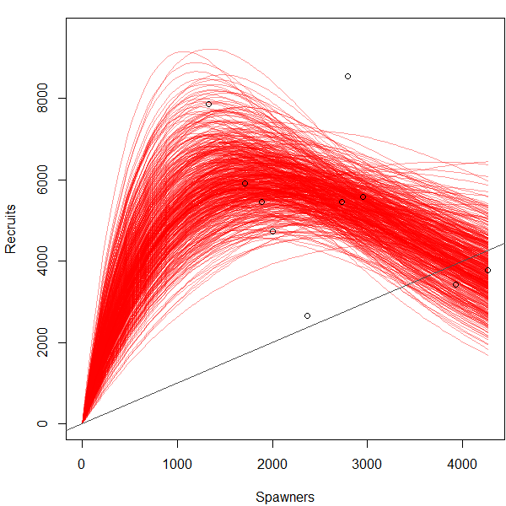
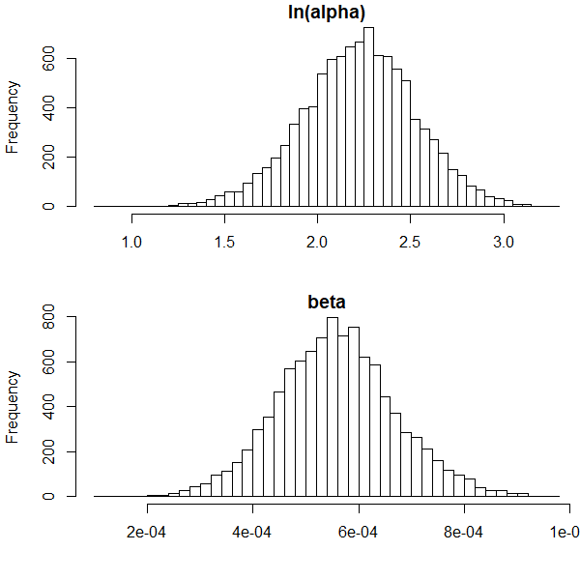
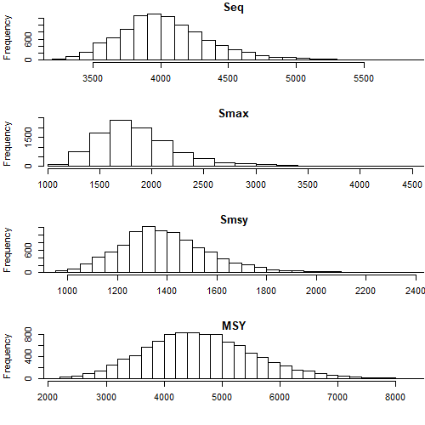
This gives:
Distributions of α and β pairs
Distributions of reference points
R
S
Seq
ln(alpha)
Smax
Smsy
beta
MSY
19
SRA - Classic Ricker Estimation – Bootstrap distributions
Notes:
19
So what this gives is a large collection of plausible alpha-beta pairs.
Plotting the Ricker curve for each pair (we call this a horsetail plot) gives a collection of plausible realities of what the true S-R relationship looks like
And it turns out that we can do even better than that!
- calculating reference points (using formulas from before) using each alpha-beta pair gives distributions of reference points

Slide 20
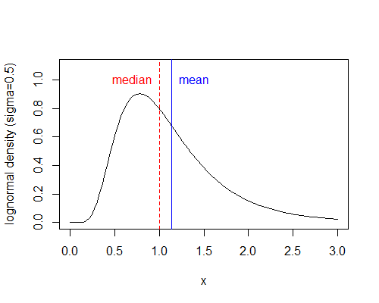
Reminder: lognormal error correction
Estimated reference points use
R
S
σ correction to α
0.3 1.05 (+5%)
0.4 1.08 (+8%)
0.5 1.13 (+13%)
0.6 1.20 (+20%)
SRA - Classic Ricker Estimation – Lognormal error correction
20
Notes:
20
So that’s really the basics of how Ricker regression works! But before we go any further, here are some small but important points to visit (in no particular order)
One, like Adam mentioned: Since we have lognormal error (median < mean), we need to correct for this to get unbiased estimates of log alpha.
This new character (log alpha prime) is used for calculating bootstrap distributions of reference points.

Slide 21
Important Consideration: Serially Correlated Process Errors - Independence among residuals may be violated! - Are residuals really exchangeable? - Important to consider will affect inferences Will cover this in more depth soon…
error
independent
ln(R/S) Residual
serially
dependent
Time
21
SRA - Classic Ricker Estimation – Serially correlated errors
Notes:
21
Also something to watch out for, that won’t be visible on the R vs S plot: Serially correlated process errors
Sometimes process errors not independent of one another
They follow a pattern over time, this year similar to last year
We say they’re serially dependent, autocorrelated, or serially correlated.
Important later when estimating Ricker parameters

Slide 22
Important Consideration: Poorly Defined Density Dependence (β)
Kenai
Sockeye
Kenai
Sockeye
Iterations
22
SRA - Classic Ricker Estimation – Censoring the impossible (1)
Notes:
22
Another thing that can happen is when Beta is poorly defined – typically happens when harvest is high (no large escapements)
Beta not convincingly positive (regression slope not convincingly negative)
What would a negative beta mean? (R/S increases with density, population explodes!)

Slide 23
Beta must be greater than zero.
β
β<0
R
ln(α)
(intercept)
= 1
β is
negative
slope
ln(R/S)
S
SRA - Classic Ricker Estimation – Censoring the impossible (2)
23
Notes:
23
So we know that true beta must be positive
R/S must decrease with increasing S!

Slide 24
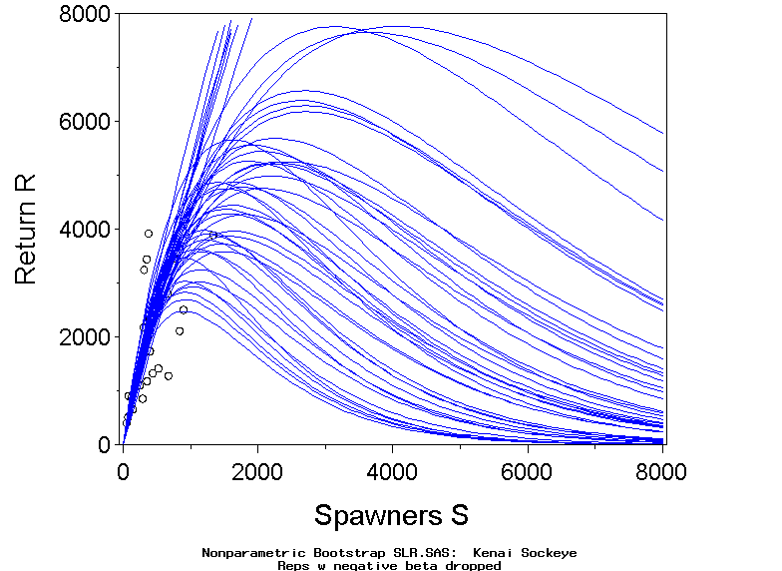
Censor the impossible
Censor
β<0
X
Kenai
Sockeye
R
S
SRA - Classic Ricker Estimation – Censoring the impossible (3)
24
Notes:
24
In keeping with interpreting bootstrap reps as possible versions of reality
We know negative beta not biologically possible
Censor (throw out) those reps
before proceeding
Do we trust associated alphas? NO
Will these reps affect reference points also? YES

Slide 25
lnα=2.5
Also impossible:
< 1
ln(α)<0
Censor ln(α)<0
R
lnα=2.0
lnα=1.0
lnα=0.0
S
25
SRA - Classic Ricker Estimation – Censoring the impossible (4)
Notes:
25
Also impossible in nature: alpha <1 (log alpha < 0)
What would that mean?
Always get fewer recruits than spawners (population goes extinct)
Throw these out too, and corresponding betas

Slide 26
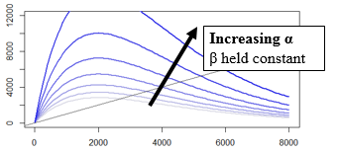
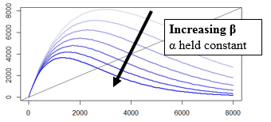
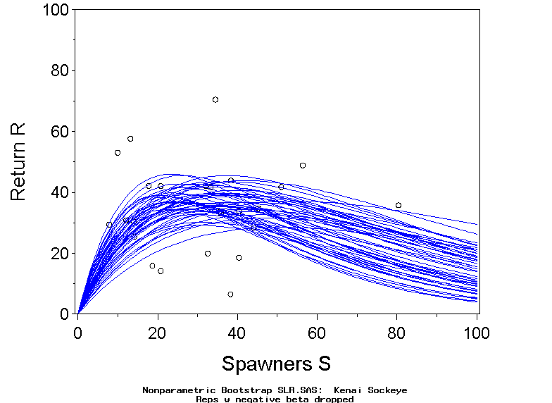
Deshka Chinook
Kenai Sockeye
R
R
S
S
S_{MSY}
Bootstrap
Distribution
S_{MSY}
Bootstrap
Distribution
Frequency
Frequency
26
SRA – Classic Ricker Estimation – Examples
Notes:
26
To bring a lot of things home, here are two examples of classic techniques in practice.
Deshka chinook - left
Good range of escapements, many large ones not replacing themselves
Different trajectories of lines show that alpha is not very well defined
Similar scale of the curves show beta is well defined
As a result, bootstrap distribution Smsy is narrow with a prominent peak
Can be confined to narrow range
Kenai Sockeye - right
High harvest rate, no large escapements, all replaced themselves
alpha well defined, beta poorly defined
Possible curves could peak at very high escapements
We see this in bootstrap distribution of Smsy
(Smsy could be quite large for all we know!)
Remember, what’s alpha? (productivity: R/S at low densities for population)
What data do we have? (only low-densities for population) …so it makes sense alpha is well defined.
[click]
And as a side note, I thought our two examples looked eerily similar to this graphic…
On the one side, holding beta constant, and varying alpha
On the other side, holding alpha constant, and varying beta
But anyway, we have bootstrap distributions for Smsy now, so we can use those to choose Esc Goal ranges, right?

Slide 27
Choosing an Escapement Goal
DON’T DO THIS:
90% MSY based on point estimate
S_{MSY} confidence interval
DO THIS INSTEAD:
optimal yield profile
expected yield plot
Notes:
Well, no. Because this slide says not to, in a great big font.
Turns out we can do even better than a CI for Smsy!
- Use probabilistic tools to construct an Optimal Yield Profile.

Slide 28
Finding an Escapement Goal Range α, β known
4000
3000
R
2000
1000
SY
MSY
0
0
1000
2000
3000
4000
S
28
Notes:
28
So what is an OYP, and why are they so great?
To get at what an OYP is, let’s first pretend Ricker relationship is known without error
Sustained yield in green (height of the blue curve above the replacement line)
You could construct range around S.msy that gives yield that is close to MSY.
(here, we’re saying 90% of MSY)
Perfect world – find the range of S that gets you at least, say, 90% of MSY (call this Optimal Yield)
But do we know the true curve? (NO)
What do we have? (Bootstrap reps)
How are we interpreting those? (plausible versions of reality)
That’s where the bootstrap results come in.

Slide 29
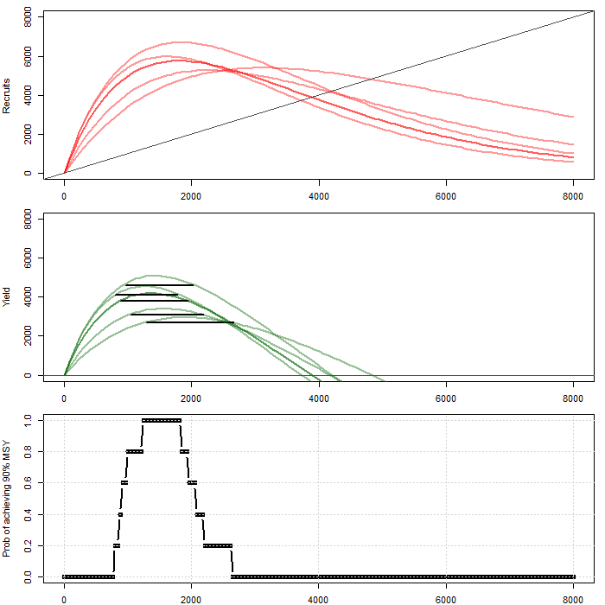
Finding an Escapement Goal Range: Optimal Yield Profile
Start simple: 5 bootstrap reps
Remember: each bootstrap rep is a possible version of reality
Each possible version of reality has its own “optimal” range, in which SY > 0.9*MSY
For each prospective S, what proportion of the 5 possible optimal yield ranges are intersected?
R
SY
Pr(SY > 0.9*MSY)
S
29
Notes:
29
To illustrate how bootstrap reps are used, first start simplistic, with 5 bootstrap reps
= 5 possible versions of true Ricker curve
= 5 possible yield curves
= 5 possible optimal ranges of escapement (where yield >90%MSY)
So then, we consider possible values of S,
count how many versions of reality have an optimal range that include the escapement we’re considering?

Slide 30
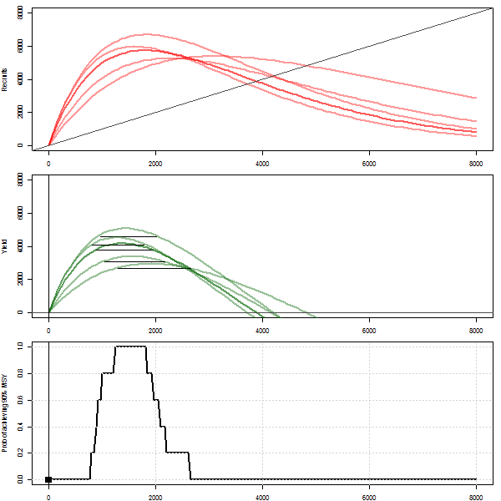
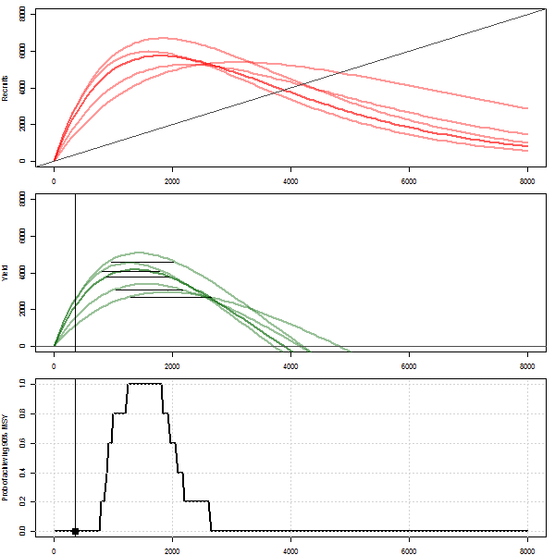
Finding an Escapement Goal Range: Optimal Yield Profile
Start simple: 5 bootstrap reps
Remember: each bootstrap rep is a possible version of reality
Each possible version of reality has its own “optimal” range, in which SY > 0.9*MSY
For each prospective S, what proportion of the 5 possible optimal yield ranges are intersected?
R
SY
Pr(SY > 0.9*MSY)
S
30
Notes:
30
Here’s an animation that might make this more clear.

Slide 31
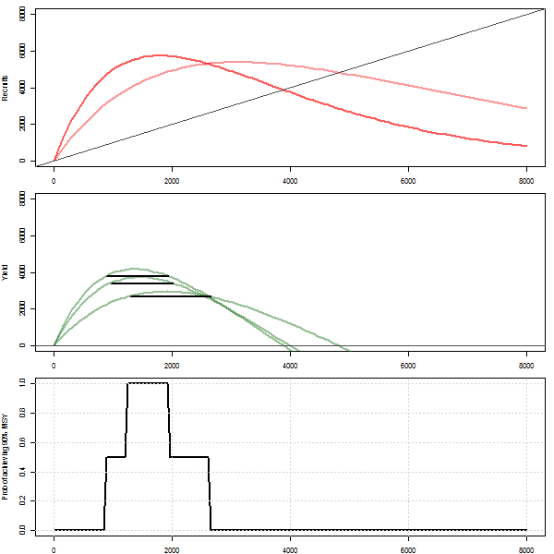
Finding an Escapement Goal Range: Optimal Yield Profile
Fill in many bootstrap reps…
Remember: each bootstrap rep is a possible version of reality
Each possible version of reality has its own “optimal” range, in which SY > 0.9*MSY
For each prospective S, what proportion of possible optimal yield ranges are intersected?
R
SY
Pr(SY > 0.9*MSY)
Interpret this proportion as probability
S
31
Notes:
31
With more and more bootstrap reps, the curve smooths out…
And remember how we’re thinking of each bootstrap rep as a plausible state of nature.
This means we can interpret a proportion of plausible states of nature as a probability
If something is true in half of our plausible states of nature, what’s the associated probability?

Slide 32
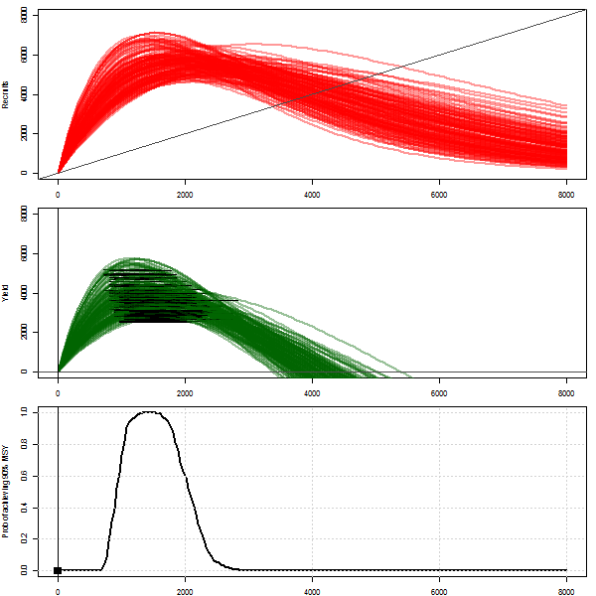
Finding an Escapement Goal Range: Optimal Yield Profile
Fill in many bootstrap reps…
Remember: each bootstrap rep is a possible version of reality
Each possible version of reality has its own “optimal” range, in which SY > 0.9*MSY
For each prospective S, what proportion of possible optimal yield ranges are intersected?
R
SY
Pr(SY > 0.9*MSY)
Interpret this proportion as probability
S
32
Notes:
32
Optimal Yield profile is a summary of the optimal ranges of all bootstrap reps
So if a greater proportion of plausible states of nature = greater probability…
Then a greater proportion of states of nature that have optimal ranges that include a given value of escapement =
greater probability of that value of escapement being within the TRUE optimal range

Slide 33
Optimal Yield Profile
Pr(SY > 0.9 MSY)
S
Possible BEGs
33
Notes:
33
So here’s a real Optimal Yield Profile in practice.
Notice it doesn’t peak at 100% (doesn’t have to!)
Prob that true Ricker curve is one that gives >90% of MSY, at that S
How to use this to get escapement goal range?
- Pick a horizontal gridline (PROBABILITY) we “like”, intersect, and project down
- Interpret this as saying that escapements in that range assuring at least THAT% probability of achieving 90% of MSY.
- or, pick a range, and read probabilities from the curve!
Quickly find that it’s a trade-off
If want high performance (high certainty of achieving near-maximal yield)
pick an upper gridline, (BUT must manage within narrow range)
If can’t manage that precisely, must live with lower performance
So choose gridline that results in a range of S which is compatible with management.
2 nice things about this
- flexible - can customize desired performance to ability to manage
- when you pick a goal, you also get a measure of how good it is
Example- “We propose setting an escapement goal range of 600 < S < 950,
with which we can be between 60% to 78% certain of exceeding 90% of MSY.”

Slide 34
Optimal Yield Profiles - Examples
Perfect Information
Some Information
Less Information
34
Notes:
34
Here are a few examples of what an OYP can look like
Perfect information looks like this
-you know exactly which range will yield >90% of MSY
-probability goes from 0 to 100% instantaneously
-vertical limbs
No information is flat- all S have equal prob of meeting goal
Some info is intermediate

Slide 35
Deshka Chinook
Kenai Sockeye
R
R
S
S
OY Profile
OY Profile
80-100% certain
of 0.9 MSY
40-65% certain
of 0.9 MSY
Notes:
back to our 2 examples
Deshka chinook
We have a wide range of S, well-defined Ricker curve
As a result, Optimal Yield profile peaks at 100%
Limbs steep- indicating precise information
can be confident that we’ll get good performance with our goal
(recall vertical = perfect info)
Kenai Sockeye
high harvest rate, beta poorly defined, (curve could peak at a very large S, for all we know)
And Smsy could be large - so some chance of good yield out here at high S
Optimal Yield profile peaks at only 65%
to get manageable range
can only guarantee 40% chance of achieving near-maximal yield

Slide 36
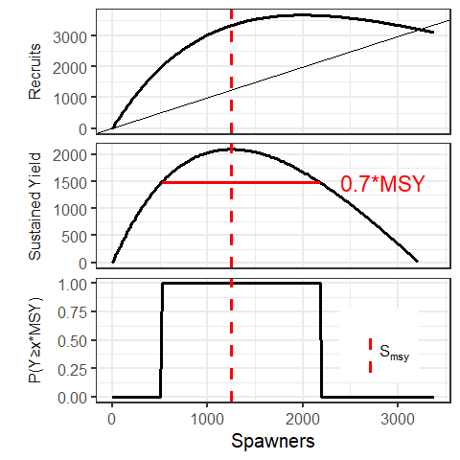
Biological Reference Points (revisited…)
To set a goal around a biological reference point we need to decide on an acceptable level of performance relative to the reference (Typically some large multiple of maximum sustained yield).
High performance requirements are associated with narrower goals, lower performance requirements are associated with wider goals.
Notes:
This is a repeat of a previous slide.
The point we want to make is that higher performance requirements are associated with narrower goals, and vice versa.
This is what OY plots would look like if we had perfect information…
To change a biological reference point into a goal range we need to decide on how close we hope to get to optimal performance.
Typically, we want to be some high percentage of MSY. The top two panels are like the last slide. The bottom panel shows the goal range under 4 separate performance expectations.
Steps, estimate the SR relationship and associated yield, decide how close you want to be to maximum yield, your goal range comes from the spawning abundances associated with the performance you want.
In the lab we will see how to express uncertainty around this goal range. The bottom panel will take on new meaning once we do that.
Often, we wont be able to estimate the stock recruit relationship and set the goal range this directly (Andrew’s section). But we will fall back on these concepts to try and find escapements associated with surplus yield.

Slide 37
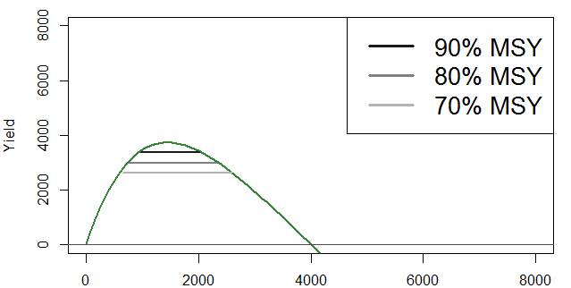
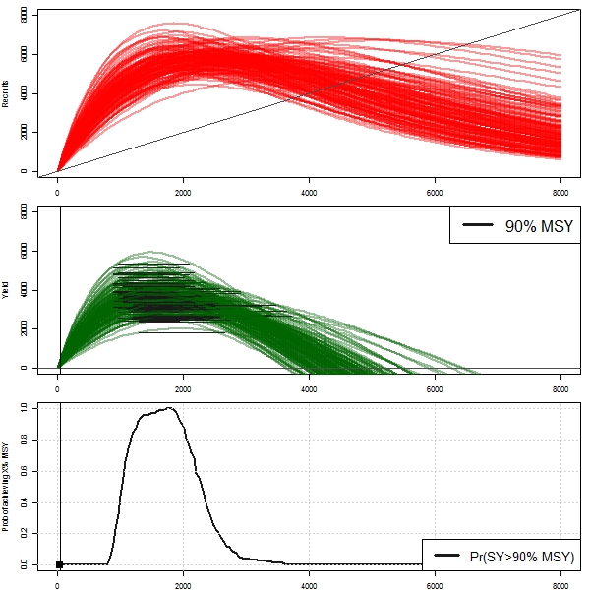
High performance requirements are associated with narrower goals, lower performance requirements are associated with wider goals.
37
Notes:
…and this is what OY plots look like with less than perfect information.
Notice that the OY plot associated with the probability of hitting 90% MSY is much narrower.
Is it easier or harder to hit a higher yield? (HARDER)
Therefore, it happens less often.

Slide 38
Expected Sustained Yield Plot
mean
p90
p95
p10
p5
38
Notes:
Another useful result from bootstrapping is what we call an Expected Yield Plot: essentially quantiles around the YIELD horsetail plot
And what you’ll find is that this can be useful when you want to refine your goal
For instance how much you could expect yield to change,
if you changed your goal

Slide 39
Deshka Chinook
Kenai Sockeye
OY Profile
OY Profile
Expected Sustained
Yield Plots
39
Notes:
back to our 2 examples one more time
Deshka chinook
steep sided yield profile, goal we can be confident in
EY curve shows how much yield
Relatively flat in that range, fairly straightforward
Kenai Sockeye
less confidence in our goal
EY curve looks interesting
At high values of escapement, there’s a chance that yield is EXTREMELY high – or negative!
Why do you think that is? (no data out there!)
And you can quickly see that usefulness of information depends on range of data

Slide 40
“Contrast” = max(S)/min(S)
Buskin Coho
25000
12500
Contrast
= 1.7
R
Contrast
= 1.7
0
0
12500
25000
S
NPCV = 1.0
0
12500
25000
S.msy
1.00
OYP
0.50
0.00
0
12500
25000
S
40
Notes:
Here’s a brief mention of Contrast, which we used to talk about in an escapement time series
defined as max(S) / min(S)
high contrast good, low contrast bad
Typical cautionary example:
Buskin Coho- low contrast from very narrow range in S – very imprecise estimate of S.msy
Horrible estimate of S.msy- NPCV = 100%
Obviously the restricted range of S is part of the problem
But- more points to the left probably will not help much

Slide 41
Early Run Russian River Sockeye
Chilkat River Chinook
“good”
Contrast
= 23.2
“bad”
Contrast
= 2.2
S.msy
S.eq
OYP
1.3
1.3
S.msy
S.eq
OYP
0.3
0.3
But terrible precision
But better precision
41
Notes:
Here are a couple more examples…
Russian River Sockeye
very high contrast - 23
but precision horrible (CV 130%) in Smsy
(left hand limb- not bending over)
Compare to
Chilkat chinook (contrast 2) npcv = 0.3 not bad
So it’s not the range of points alone
but where they are relative to the replacement line

Slide 42
Chilkat Coho
2002
brood year
1995-2001
n=7
1995-2002
n=8
NPCV
= 0.8
NPCV
= 0.1
42
Notes:
And an interesting thing happens if we get one or more large escapements that do not replace themselves
Check this out-
Chilkat Coho 1995-2001 7 brood years
Ricker not bending over, horrible estimate
hard to pick a goal
Add 2002 brood year
big escapement- doesn’t replace itself
Suddenly a very good estimate of S.msy
Easy to set a goal
BUT highly influential point begs the question: Was 2002 biased in some way? Or outlier in some way in terms of productivity?
Either we suddenly have the information we need, or else an illusion of certainty

Slide 43
Overfishing Profile
Spawners Counted in Aerial Survey
Notes:
Another plot you might see is called an Overfishing Profile, which is related to the Optimal Yield Profile
By overfishing we mean fishing hard enough to reduce the escapement such that
there is a reduction in yield below, say, 90% MSY
The best way to explain this is to go back to . . .

Slide 44
Escapements representing “overfishing” (SY < 90% MSY)
R
SY
MSY
0
Note: this range also gives escapements with (SY < 90% MSY), but we’re only concerned about escapement being too low, not too high
44
Notes:
Let’s pretend one more time that the Ricker relationship is known without error
Over here (red) is the range of escapements that leads to “overfishing”
if overfishing is defined as reducing the yield to below 90% of maximum

Slide 45
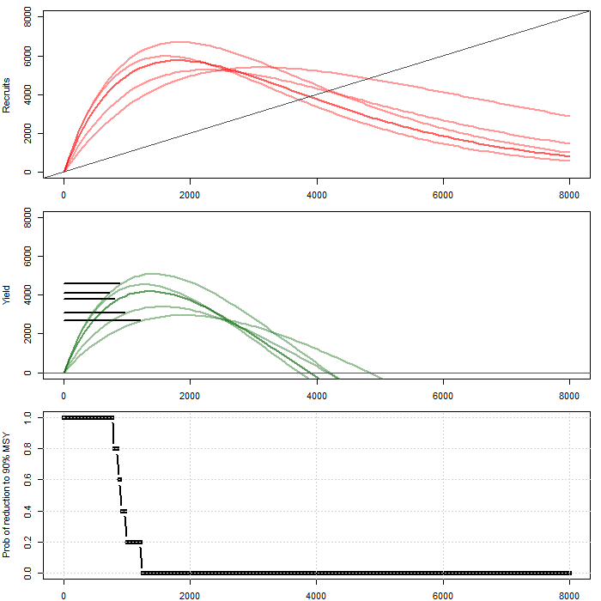
How many states of nature lead to overfishing?
Start simple: 5 bootstrap reps
Remember: each bootstrap rep is a possible version of reality
Each possible version of reality has its own “overfishing” range, in which SY < 0.9*MSY (and S < Smsy)
For each prospective S, what proportion of the 5 possible overfishing ranges are intersected?
R
SY
Pr(SY < 0.9*MSY)
S
45
Notes:
So one more time, start with 5 bootstrap replicates,
Consider values of S – what proportion of our plausible states of nature lead to overfishing?

Slide 46
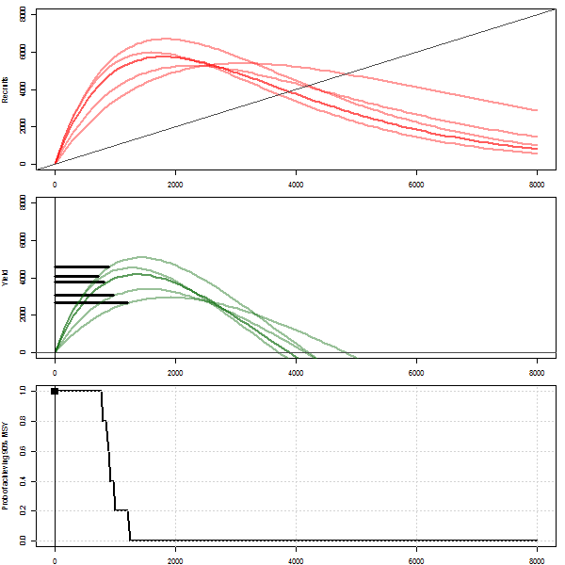
How many states of nature lead to overfishing?
Start simple: 5 bootstrap reps
Remember: each bootstrap rep is a possible version of reality
Each possible version of reality has its own “overfishing” range, in which SY < 0.9*MSY (and S < Smsy)
For each prospective S, what proportion of the 5 possible overfishing ranges are intersected?
R
SY
Pr(SY < 0.9*MSY)
S
46
Notes:
…here’s that animation again…

Slide 47
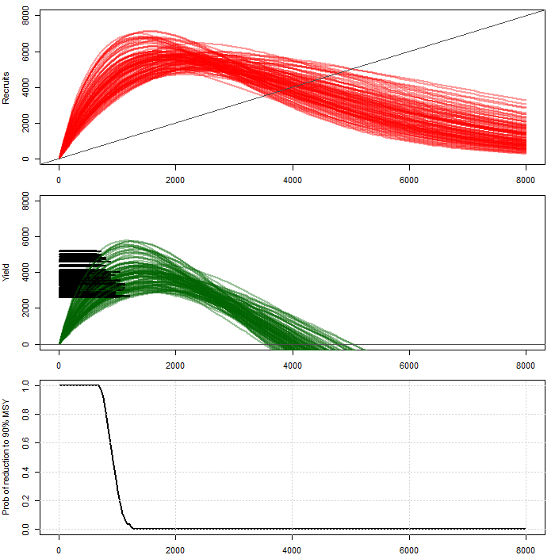
How many states of nature lead to overfishing?
Fill in many bootstrap reps…
Remember: each bootstrap rep is a possible version of reality
Each possible version of reality has its own “overfishing” range, in which SY < 0.9*MSY (and S < Smsy)
For each prospective S, what proportion of possible overfishing ranges are intersected?
R
SY
Pr(SY < 0.9*MSY)
Interpret this proportion as probability
S
47
Notes:
Again, as we add bootstrap replicates, the curve smooths out
And again, remember we’re interpreting the proportion of bootstrap reps (states of nature) as probability

Slide 48
Overfishing and Yield Profiles
Spawners Counted in Aerial Survey
Notes:
Here’s the Overfishing and Optimal Yield Profiles next to one another one more time
Notice that they start out as complements of one another

Slide 49

How many states of nature lead to overfishing?
Fill in many bootstrap reps…
Remember: each bootstrap rep is a possible version of reality
Each possible version of reality has its own “overfishing” range, in which SY < 0.9*MSY (and S < Smsy)
For each prospective S, what proportion of possible overfishing ranges are intersected?
R
SY
Probability
Interpret this proportion as probability
S
49
Notes:
But the two curves give you different information
because the OFP is only concerned about escapements being too low, not too high

Slide 50
Mechanics
of Escapement Goal Analysis in Alaska
Stock-Recruit Analysis:
Ricker Stock-Recruit Relationship
Classic Ricker Estimation
Lab: Estimation and Uncertainty
Problems and Special Issues
Bayesian State-Space Models
50
Notes:
50

Slide 51

COPY AND PASTE VALUES
SRA - Lab
51
Notes:
51
Data are simulated, so first thing to do:
SELECT GREEN INPUT BOX
COPY AND PASTE (special) VALUES to fix
SPREADSHEETS- EASY TO MAKE MISTAKES
SAVE A NEW COPY
PAY ATTENTION TO DETAILS
ASK QUESTIONS!
HANDOUTS

Slide 52
Aside: Bootstrapping makes sense!
Idea 1: Statistical inference comes from the sampling distribution
That is, distribution of estimator over all possible datasets
Idea 2: If a dataset is representative of a population, then the population must resemble the dataset
Idea 3: Sampling the dataset with replacement is like sampling a conceptually infinite population with the same characteristics as the dataset
Resampling with replacement 10,000 times is like taking 10,000 new “datasets”
Sampling distribution!
original dataset
4 | 8 | 3 | 1 | 7 | 6 | 9
conceptually infinite population
… | 4 | 8 | 3 | 1 | 7 | 6 | 9 | 4 | 8 | 3 | 1 | 7 | 6 | 9 | 4 | 8 | 3 | 1 | 7 | 6 | 9 | …
new “datasets” from bootstrapping
3 | 7 | 4 | 9 | 4 | 9 | 1
4 | 4 | 1 | 9 | 6 | 6 | 7
3 | 1 | 9 | 1 | 4 | 3 | 4
…
52
Lab - Bootstrapping
Notes:
52
And here’s another quick statistical “aside”, since we just spent some time bootstrapping
Bootstrapping gets thought of as a mysterious black box or else statistical voodoo. But it actually makes some sense when you think about it.
Let’s forget about fish for a moment and hold a simpler toy example in our brains. Let’s say we want to estimate the mean height of people living in [Anchorage].
So we take a sample of people.
Could we have taken a different sample of people? Would the sample average be different this time?
It turns out that all our Stats 101 tools come from asymptotic methods for describing SAMPLING DISTRIBUTION

Slide 53

hamachan.shinyapps.io/Spawner_Recruit/
Upload either S-R or run by age
Does standard regression or AR(1) - or selects automatically using likelihood ratio
Data-tested, biometrician-approved
Lab – Hamachan’s App
Notes:
Here’s another “aside” – since we just spent a bunch of time & energy powering through the lab:
Hamachan has built an extremely useful tool to do everything you just did (only more so)
It’s what’s called a Shiny app, which runs R code in the background, but all you see is a website (with a web link)
Upload your own data, and off you go!

Slide 54

Mechanics
of Escapement Goal Analysis in Alaska
Stock-Recruit Analysis:
Ricker Stock-Recruit Relationship
Classic Ricker Estimation
Lab: Estimation and Uncertainty
Problems and Special Issues
Measurement Error
Serial Correlation
Age Structure Issues
54
Notes:
54
We need to talk about a couple of “red flag” issues to watch out for
If present in your data, it may pay to be somewhat skeptical of your results
Then a little about age structure

Slide 55
Ricker SR Model
1.2
0.8
ln(R/S)
0.4
0.0
0
5,000
10,000
15,000
-0.4
S
Assumptions from regression are violated
{S} known w/o error
{S,R} independent
. . .
55
Problems & Special issues: Measurement Error (1)
Notes:
55
Reason for this goes back to the way we analyzed our data
Our analysis is equivalent to simple linear regression,
So- we’re subject to assumptions of regression
A couple of which are that
- X & Y known with no meas error
- Data points are independent of one another
- when evaluating independence, think “does information about one data point tell me something about another data point?”

Slide 56
Model for Simulated Data
Ŝ₁
Error
S₁
Ricker
Harvest
Policy
R₂
Ŝ₂
Error
S₂
H₂
Ricker
R₃
HP
Ŝ₃
Error
S₃
H₃
Ricker
R₄
HP
Ŝ₄
Error
S₄
H₄
repeat to y=20
Problems & Special issues: Measurement Error (2)
56
Notes:
56
Well- in reality
rarely do we measure escapement without error, and
never are the individual {S,R} pairs independent
Usually reality goes something like this
Start with S1
.
.
.
Finally - S estimated with measurement error, observe S.hat
In fact,
this is how we generated the simulated for your lab spreadsheet, as you saw

Slide 57
Investigation through Meta-Simulation…
α, β, σ, . . .
Data
S^₁
Error
S₁
Ricker
R₂
Harvest
Policy
S^₂
Error
S₂
C₂
Ricker
R₃
HP
Regression
Methods
S^₃
Error
S₃
C₃
Ricker
R₄
HP
S^₄
Error
S₄
C₄
repeat to y=20
Repeat
300X
57
Problems & Special issues: Measurement Error (3)
Notes:
57
We can automate this whole process [many] times to see what happens when regression assumptions violated
-Set true parameter values to whatever we want them to be (and then we know what they are)
-Simulate SR data as before
-Estimate the parameters the way you did in lab
-Repeat 300 X to see what happens: how estimates agree with reality
-especially S^msy

Slide 58


Distribution of Estimates
Low Harvest Rate
ln(α)
β
σ
S_{MSY}
ln(α)=2.0, β=0.001, σ=0.5, S_{MSY}=748, σ_{S}=0.3
SRA - Measurement Error
Problems & Special issues: Measurement Error (4)
58
Notes:
58
Turns out that when you introduce measurement error in S (CV 30%) – note: this is error in measuring S, not range of S
With low harvest rate, 20%
This is what frequency distributions of estimates look like, compared to true values (vertical blue bars)
Turns out,
lnalpha and beta biased low,
Smsy high

Slide 59


Distribution of Estimates - Moderate Harvest
ln(α)
β
σ
S_{MSY}
ln(α)=2.0, β=0.001, σ=0.5, S_{MSY}=748, σ_{S}=0.3
SRA - Measurement Error
59
Problems & Special issues: Measurement Error (5)
Notes:
59
At a moderate harvest rate – about 50-60%
bias is smaller in all cases

Slide 60


Distribution of Estimates - High Harvest Rate
ln(α)
β
σ
S_{MSY}
SRA - Measurement Error
ln(α)=2.0, β=0.001, σ=0.5, S_{MSY}=748, σ_{S}=0.3
60
Problems & Special issues: Measurement Error (6)
Notes:
60
Interestingly, at high harvest rate (escapements small)
opposite effect
negative bias in Smsy

Slide 61

Low-Moderate Harvest Rate Ŝ_{MSY} Biased High, Precision Misleading
True dispersion (mid 80% of estimates)
Estimated dispersion (avg CI endpoints)
(----SONAR--->
(-----AERIAL SURVEYS----->
(-WEIRS----->
(---FOOT SURVEYS-------------->
(-TOWERS-->
61
(-----M/R----->
Problems & Special issues: Measurement Error (7)
Notes:
61
So this figure looks at when we repeat this process, with multiple degrees of measurement error. It takes a little unpacking.
X axis is the degree of measurement error
Y axis expresses estimated Smsy
Blue bars show true dispersion: middle 80% of the point estimates
Red bars show estimated dispersion: - average of the lower & upper 80% confidence interval endpoints
With no ME, no problem, estimates are relatively precise and unbiased, and estimated & true dispersion agree
but as meas error increases, estimates get
less precise and
more biased
Greater dispersion than estimated

Slide 62

High Harvest Rate Ŝ_{MSY} Imprecise or Biased Low
True dispersion (mid 80% of estimates)
Estimated dispersion (avg CI endpoints)
(----SONAR--->
(-----AERIAL SURVEYS----->
(-WEIRS----->
(---FOOT SURVEYS-------------->
(-TOWERS-->
SRA - Measurement Error
62
(-----M/R----->
Problems & Special issues: Measurement Error (8)
Notes:
62
heavy harvest most escapements small (inset)
You get the opposite effect: ME causes negative bias in Smsy
Small ME- intervals wide (unbounded upper)
Large ME- strong, consistent negative bias
worst is that estimates look fairly precise, but they’re too low.
Luckily, combination of intense management and imprecise escapement estimates should be rare

Slide 63
ME bias explained
o TRUE
o ESTIM
Direction of perturbation is predictable, depending on S.
1) S = S_{MAX} : slope of perturbation equals –β.
2) S < S_{MAX} : steeper
3) S > S_{MAX} : flatter
Low harvest rate (large S)
ME flattens scatter.
α, β down; S_{MSY} up
High harvest rate (small S)
ME steepens scatter.
α, β up; S_{MSY} down
S_{MAX}=1000
slope = -β
Kehler et al. 2002. Measurement error and bias in the maximum reproductive rate for the Ricker model. CJFAS 59: 854-864.
63
Problems & Special issues: Measurement Error (9)
Notes:
63
Why so dependent on harvest regime?
Turns out that the perturbation is predictable depending on true S
steeper at small S
flatter at large S
So depending on where escapements fall relative to Smax, slope is estimated as steeper or flatter than it should be
So at low harvest, where S generally > Smax; ME flattens scatter.
Estimated Alpha (intercept) and beta (slope) decrease, so estimated Smsy increases.
And at high harvest, where S generally < Smax, ME steepens scatter.
Estimated Alpha and beta increase, so estimated Smsy decreases.

Slide 64
Bias due to Measurement Error in S Summary
Measurement Error CV < 0.2
Bias is small
Measurement Error CV > 0.2
Low, Moderate, or Mixed Harvest Rate
Ŝ_{MSY} MAY be estimated too high
Consistently High Harvest Rate
Ŝ_{MSY} MAY be estimated too low
64
Problems & Special issues: Measurement Error (10)
Notes:
64
So to bring it all home, here’s a summary of how BIAS is affected
This says nothing about precision
Also, bias means estimates are too high or low on average - Any given estimate could be off in either direction

Slide 65


Serial Correlation
ln(R/S)
Residual
Time
Simple Linear
Regression
$$\ln\left(\frac{R_{y}}{S_{y}}\right)=\ln{(}α)−βS_{y}+ε_{y}$$
AR(1)
Autoregressive
Lag 1
$$\ln\left(\frac{R_{y}}{S_{y}}\right)=\ln\left(α\right)−βS_{y}+φε_{y−1}+a_{y}$$
65
Problems & Special issues: Serial Correlation (1)
Notes:
65
Second thing to look out for . . . serial correlation
That is, if Residuals follow a pattern wrt Time instead of being independent and random.
If ignored- serious bias in Smsy in either direction
Good news: “easy” fix: model w extra terms
Simplest times series model is AR1
Take Simple Linear Regression model, add a term
phi is the autocorrelation coefficient, between -1 and 1
if phi near 1, lots of serial correlation
No simulation exercises to illustrate
3 examples of data sets where AR1 appropriate
show effect of ignoring it

Slide 66
Example 1 (Deshka Chinook data)
SLR Residuals
R vs S
OY Profile
Model
Simple Regression
Autoregressive
AR1
66
Problems & Special issues: Serial Correlation (2)
Notes:
66
naive SLR model in red
AR1 model in blue
effect of ignoring serial correlation small
EG perhaps slightly too small at upper end

Slide 67
Example 2 (Egegik Sockeye data)
SLR Residuals
R vs S
OY Probability Profile
Model
Simple Regression
Autoregressive
AR1
SRA - Serial Correlation
Problems & Special issues: Serial Correlation (3)
67
Notes:
67
high harvest rate, small escapements
effect of ignoring serial correlation bigger
EG too wide and too high
Allowing the model to explain variability better -> Better information out?

Slide 68
Example 3 (Ugashik Sockeye data)
Regression Residuals
R vs S
OY Profile
Model
Simple Regression
Autoregressive
AR1
SRA - Serial Correlation
Problems & Special issues: Serial Correlation (4)
68
Notes:
68
Another example with strong autocorrelation
Again, EG from Simple Reg would have been too wide and too high
Again, AR1 model gives more usable OYP
Bottom line- If see evidence of serial correlation, we should use a model that includes it
Put another way, we need to estimate Ricker params in context of that serial correlation

Slide 69
Serial Correlation Illustrated
Ugashik Sockeye
Simple Regression fit
Density dependence is constant
Productivity fluctuates
69
Problems & Special issues: Serial Correlation (5)
Notes:
69
In order to illustrate what’s happening, here’s the Ugashik Sockeye with a simple regression line.
We can express the effect of serial autocorrelation by splitting the dataset into 3 time periods
What we see:
- relationship moves around vertically
- Most interesting: slope (beta) at any given time appears steeper than overall slope (roving intercept muddies the true relationship)
[click]
True slope should look something like this.
If we were to ignore this and pool the data, slope appears flatter
hence the estimates of Ricker params change when you include serial correlation in the model
A good way to think of AR1 model as regression in which intercept is slowly changing
[click]
density dependence (beta) is constant, but productivity (alpha) fluctuates with ocean conditions or other factors

Slide 70
Serial Correlation: What to Do
Inspect residuals from Simple Regression model (plot vs time).
Test for 1st order autocorrelation w/ Durbin Watson test.
If no evidence of autocorrelation, use Simple Regression results.
Otherwise:
Use AR(1) model.
See your biometrician!
Note that inference applies to overall time series; recent past may differ.
70
Problems & Special issues: Serial Correlation (6)
Notes:
70

Slide 71
Non-Stationary Residuals
STOP
(and think … or call a meeting)
SRA may not be appropriate – What was true at the beginning of the time series may not be true at the end!
α, β, S_{EQ} may be changing
Stock assessment accuracy may have changed
71
Problems & Special issues: Serial Correlation (7)
Notes:
71
Here’s a case of autocorrelation taken to the extreme
In this case, productivity probably hasn’t stabilized around a central tendency, in which case SRA may not be appropriate!

Slide 72
Mechanics
of Escapement Goal Analysis in Alaska
Stock-Recruit Analysis:
Ricker Stock-Recruit Relationship
Classic Ricker Estimation
Lab: Estimation and Uncertainty
Problems and Special Issues
Measurement Error
Serial Correlation
Age Structure Issues
72
Notes:
72
Next up, we’ll talk a little about age structure issues

Slide 73
Age Composition in SRA
Sample size: How many fish must be aged to estimate S_{MSY} with SRA?
Missing Data: What to do when age composition information is missing?
73
Problems & Special issues: Age Structure (1)
Notes:
73
Specifically, two big question: What sample size do we need, and what do we do with missing age data?

Slide 74
Meta-Simulation
α, β, σ, . . .
Data
S^₁
Error
S₁
Ricker
R₂
Harvest
Policy
S^₂
Error
S₂
C₂
Ricker
R₃
HP
Regression
Methods
S^₃
Error
S₃
C₃
Ricker
R₄
HP
S^₄
Error
S₄
C₄
repeat to y=20
Repeat
300X
74
Problems & Special issues: Age Structure (2)
Notes:
74
Meta-simulation to the rescue!
Remember, for this kind of investigation we
- set the parameters to whatever we want them to be
- Simulate “true” and observed datasets
- See what happens with regard to estimation.

Slide 75

Sample Size Larger is not necessarily better
S^_{MSY}
Problems & Special issues: Age Structure (3)
75
Notes:
75
It turns out that the answers are striking!
In this case, the parameters were set to extremes
- Essentially to maximize importance of getting the age comp right
- (low process error, low meas error, exteme age comp that varies much from one brood year to the next)
As you can see,
Benefit of more scales tapers off quickly
X axis: number of age samples
Y axis: Estimating Smsy

Slide 76
S_{MSY} Sampling Error
CONCLUDE: 100 scales is sufficient
76
Problems & Special issues: Age Structure (4)
Notes:
76
Here’s the same simulation, just looking at the width of intervals vs number aged.
100 scales more than sufficient
even for worst case scenario!
What’s happening:
Imprecision due to scale sampling swamped by other variability in the system, specifically process error and measurement error

Slide 77

Age Composition Imputation
Total
of many years
based on one year of data
R fluctuations dampened
R
1981 1984 1987 1990 1993 1996
brood year
77
Problems & Special issues: Age Structure (5)
Notes:
77
Here’s another simulation, which is really imputation taken to the extreme
- We got one year of age data
- We then applied that year’s age comp estimate to all other years
What we see:
Huge dampening effect on number of recruits
But reasonably good estimates

Slide 78
Age Composition: Summary
Sample size: 100 valid ages is sufficient.
Missing data: Lack of age composition estimates need not prevent stock-recruit analysis. Impute from existing data or other stocks.
State-Space models may be helpful
78
Problems & Special issues: Age Structure - Summary
Notes:
78
So here’s a summary:
With regard to sample size, 100 valid ages is sufficient but need to be representative
With regard to missing data, imputation can still result in reasonable inferences
So far: bias in S^msy from 0 to +15%
Precision can go up or down.
SIMULATIONS WITH 6MA IMPUTE and 6ma (compare)

Slide 79
Mechanics
of Escapement Goal Analysis in Alaska
Stock-Recruit Analysis:
Ricker Stock-Recruit Relationship
Classic Ricker Estimation
Lab: Estimation and Uncertainty
Measurement Error, Serial Correlation
Age Structure Issues
State-Space (Full Probability) Models
79
Notes:
79
Classical regression methods are fine most of the time, but not always
Maybe:
- biased (measurement error)
- intervals not wide enough (underestimate true uncertainty)
- not flexible enough (autocorrelation)
This section- newer class of models “State Space”
-more flexible to complex situations
-less subject to bias

Slide 80
Things classical regression methods cannot handle
Measurement error in S
Measurement error in anything else
(Serial autocorrelation)
Missing escapement or return data
Additional information or model complexity
Trending productivity or age at maturity
Multiple indicators of run size
etc…
80
SRA – State-Space Models (1)
Notes:
80

Slide 81
Bayesian State-Space models
Stochastic state process (unobserved)
Stochastic observation process
Two pieces:
State variables (unobserved)
Observed variables
Year y
Year y+1
Year y+2
81
SRA – State-Space Models (2)
Notes:
So what is a State-Space model?
A State-Space model is made up of two pieces…

Slide 82
Bayesian State-Space models in context…
Unobserved values:
True S, R, H
- By brood year
- By calendar year
Observed data
Run size (maybe multiple indices)
Harvest
Age composition
Year y
Year y+1
Year y+2
Stochastic state process:
Ricker S-R parameters & linkage
Process error
Autocorrelation
Time-trending parameters
Stochastic observation process - obs error in:
S (or run size)
Harvest
Age composition
82
SRA – State-Space Models (3)
Notes:
Putting this in context of a Spawner-Recruit Analysis,
The stochastic state process is the true abundance changing through time with
The Spawner -> Recruit relationship HOWEVER we want to specify it
The Recruit -> Spawner linkage, through harvest
The stochastic observation process is how we observe the data (WITH error)

Slide 83
Bayesian models in general provide greater flexibility in modeling
Generally, if you can express the model, you can fit the model
Greater modeling flexibility can allow a better use of information
We can incorporate what we know
(variances may get smaller)
We can be honest about what we don’t know (precisely)
(variances may get bigger, but more honest)
Many classical assumptions no longer apply:
…S known without error, S-R pairs independent…
(can express the model like it really is – without simplification!)
83
SRA – State-Space Models – Bayes Background (1)
Notes:
Basic idea that motivates this section:
If reality is complex, then we need a model that can express that complexity.
In order to express that complexity, we need a modeling framework that is flexible.
It turns out that flexibility is where Bayesian models shine!

Slide 84
Bayesian inference: Everything is probability
Classical statistics
Parameters: fixed & unknown
Data: Random variable(s)
“95% confident* that θ is between A & B”
*95% of the intervals that could be drawn using this method will contain θ
“Reject H₀: θ≤θ₀ (p-val=xxx)*”
*if θ were equal to θ₀, the probability of getting the data we got, or something more extreme, is equal to xxx
Bayesian statistics
Parameters: Random variable(s), possibly conditional on data
“95% probability that θ is between C & D”
“Prob(θ>θ₀) = yyy”
84
SRA – State-Space Models – Bayes Background (2)
Notes:
Now we’re talking about Bayesian modeling, so I do have to take a step back and talk a little about that for a few slides.
We won’t go too deep into the weeds on this, but essentially,
Bayesians treat parameters as random variables, and model them probabilistically
The ability to make probabilistic statements about parameters really changes the kind of inferential statements we can make
MUCH more intuitive
Definitely would have been wrong in Stat 101!

Slide 85

*Note: this is definitely not a course on Bayes!
Bayes’ Theorem essentially gives
Posterior = Likelihood X Prior
Think: “Updating information”
Prior: information we had before collecting data
Likelihood: information in the data
Posterior: updated information after incorporating the data
85
SRA – State-Space Models – Bayes Background (3)
Notes:
Here’s the obligatory Bayes’ Theorem slide.
A really nice way to think of Bayesian methodology in general is that we’re updating information:
The information we had before collecting data (we call this the prior)
The information in the data, given how we specified the model (we call this the likelihood)
And finally the information that we get out at the end (call this the posterior) which contains all our inferences.

Slide 86
*Note: this is definitely not a course on Bayes!
A quick note on Priors:
Think: “Updating information”
Prior: information we had before collecting data
Maybe little to no information -> “non-informative prior”
Maybe just a range of plausible values
Maybe precise & defensible!
Priors don’t have to be subjective or scary
Opportunity to add information (or not)
BUT: Non-informative priors need to be specified correctly
Consult your friendly neighborhood biometrician
86
SRA – State-Space Models – Bayes Background (4)
Notes:
And a quick note on priors:
Not too long ago, many people were afraid of priors, and thought they were subjective and/or “made up on the spot”
but they don’t actually have to be!
Maybe you don’t have any information about a parameter, in which case you can use what’s called a non-informative prior
Maybe all you have is a range of values that you know a parameter CAN’T take (like we know beta and log alpha have to be positive!)
Or maybe we have some really good information – in which case, the scientific thing might be to use it!
I don’t have this on the slide, but you also can (AND SHOULD) try different priors to see how inference is affected (call this a sensitivity analysis)
In many cases, there is so much information in the data that the choice of prior doesn’t matter much in the end.
The take-home is that priors are an opportunity to add information (or not)
And you’ll notice the caveat at the end that non-informative priors do need to be specified correctly
(scale-dependence can mess things up – maybe it needs to be non-informative on the log scale, or inverse scale…)

Slide 87

Markov Chain Monte Carlo (MCMC)
Essentially a random walk through posterior parameter space
But similar to bootstrapping in how we use it
Again, think: “possible realities”
Iterations no longer independent of each other - this is fine, just let it walk long enough to “explore”
Toy example at right:
Unknown mean μ
Unknown standard deviation σ
87
SRA – State-Space Models – MCMC (1)
Notes:
Numerically, Bayesian methods often use a technique called Markov Chain Monte Carlo
Which can feel similar to bootstrapping in that what you get out is a large collection of plausible values for each parameter
But it’s worth mentioning that it’s actually more of a random walk through the parameter space
(each iteration depends on the one before it)
Really, the only take-home is you need to allow enough iterations for the algorithm to fully “explore” the parameter space
…and my toy example that’s running here is estimating an unknown mean and standard deviation from a sample
X axis: standard deviation
Y axis: mean

Slide 88

Markov Chain Monte Carlo (MCMC)
Essentially a random walk through posterior parameter space
But similar to bootstrapping in how we use it
Again, think: “possible realities”
Iterations no longer independent of each other - this is fine, just let it walk long enough to “explore”
Toy example at right:
Unknown mean μ
Unknown standard deviation σ
88
SRA – State-Space Models – MCMC (2)
Notes:
And if you let the algorithm run long enough, the distribution will probably smooth out into something reasonable
And it’s worth noting that the distribution for the mean is fairly nearly Normal (ignore the couple of weird values at the end of the lower tail)
And the distribution for the standard deviation is positively skewed.

Slide 89
With this in mind, some terms you may encounter…
Gibbs Sampling: A common algorithm for MCMC that is used by BUGS (Bayesian inference Using Gibbs Sampling) and JAGS (Just Another Gibbs Sampler
Chains: Sequences of MCMC iterations, each with different starting values. Running 3 chains is common.
Burn-in (or Warm-up): The first several MCMC iterations that are considered to be influenced by starting values and discarded.
Thinning: Possibly only keeping every n^{th} iteration
89
SRA – State-Space Models – MCMC (3)

Slide 90

100 Iterations
With this in mind, some terms you may encounter …
Convergence: When the MCMC samples have effectively characterized the posterior distribution. This may take many thousand iterations!
Trace plots: Plotting MCMC samples in sequence, to provide a visual assessment of convergence
N.eff, Gelman-Rubin Convergence Diagnostic, etc: Various diagnostic stats that use variation between chains and along chains to assess convergence
90
SRA – State-Space Models – MCMC (4)
Notes:
Note: these trace plots are from a very simple and “nice” model.
In more complex cases, each chain may slowly “wander”… this model will not have converged!

Slide 91

1000 Iterations
With this in mind, some terms you may encounter …
Convergence: When the MCMC samples have effectively characterized the posterior distribution. This may take many thousand iterations!
Trace plots: Plotting MCMC samples in sequence, to provide a visual assessment of convergence
N.eff, Gelman-Rubin Convergence Diagnostic, etc: Various diagnostic stats that use variation between chains and along chains to assess convergence
91
SRA – State-Space Models – MCMC (5)

Slide 92

10,000 Iterations
With this in mind, some terms you may encounter …
Convergence: When the MCMC samples have effectively characterized the posterior distribution. This may take many thousand iterations!
Trace plots: Plotting MCMC samples in sequence, to provide a visual assessment of convergence
N.eff, Gelman-Rubin Convergence Diagnostic, etc: Various diagnostic stats that use variation between chains and along chains to assess convergence
92
SRA – State-Space Models – MCMC (6)

Slide 93
Classic Ricker Model
lnα
β
σ
S_{i}
fit.R_{i}
R_{i}
lognorm
{i = 1:20}
Can be analyzed using simple linear regression
Assumes:
{S_{i}} fixed, known without error
{S_{i}, R_{i}} data pairs independent
93
SRA – State-Space Models – Classic model (1)
Notes:
93
Some examples of this in action!
First example- classic Ricker model that we’re familiar with – Sometimes useful to express models as a flowchart
-Parameters in green: lnalpha, beta, sigma
-Data in blue: R
Escapement S assumed fixed and known
fitted value of R as a function of S, lnalpha, beta
multiply by lognormal error
observe R for data
Repeat independently for each year of data.
Notice- every brood year is independent of the rest
S is fixed and known

Slide 94
Ricker 1 classic.odc
lnα
β
σ
S_{i}
fit.R_{i}
lognorm
R_{i}
{i = 1:20}
94
SRA – State-Space Models – Classic model (2)
Notes:
94
We saw this as a flowchart, this is what it looks like in CODE (WinBUGS or JAGS)

Slide 95
Probability Distributions
State-Space vs Bootstrap
Equivalent inferences from equivalent model!
OY Profiles
95
SRA – State-Space Models – Classic model (3)
Notes:
95
Inference for lnalpha, compare with bootstrap
Basically equivalent!

Slide 96
State-Space Model
α
β
σ
U
σ_{H}
S^₁
S₁
Rfit2
lnorm
R₂
S^₂
S₂
H₂
H^₂
Rfit3
lnorm
R₃
S^₃
S₃
H₃
H^₃
Rfit4
lnorm
repeat to y=20
96
SRA – State-Space Models – Model building (1)
Notes:
96
So let’s use our new flexibility to build a more realistic model . . .
S leads to R through the Ricker relationship as before
But - link from R to S through the harvest policy
(and harvest policy / fishing power affects S and ability to estimate SR params)
Harvest policy is simple in this case
one parameter U = exploitation rate
S subject to meas error
and so is H (SWHS, or creel survey)
We observe Shat and Hhat instead of true S and H
Familiar? I’ve recreated the model that was used to simulate the data

Slide 97
H₃
S[y] <- R[y] – H[y]
S.hat[y] ~ dlnorm(log.S[y],tau.log.S.hat)
H.hat[y] ~ dlnorm(log.H[y],tau.log.H.hat)
97
SRA – State-Space Models – Model building (2)
Notes:
97
And here’s the code to express it
Really, we just added a couple new pieces:
Link between Recruits and Spawners
Measurement error in S and H
Bottom line:
we’re being explicit and realistic about where the data came from

Slide 98
H₃
True
FPM
Classical
ln(α)
β
S_{MSY}
2.0
0.00100
748
1.37
0.00072
796
1.32
0.00062
914
98
SRA – State-Space Models – Model building (3)
Notes:
98
And as a result
estimates have moved toward true values

Slide 99

Typical Result S_{MSY} Distribution
State-Space Classical
99
SRA – State-Space Models – Model building (4)
Notes:
So here’s a comparison of inferences to Smsy (State-Space vs Classical)
Blue: State-Space
Red: Classical
Black vertical line: true value of Smsy
You’ll notice two things:
State-Space distribution moved closer to true value
State-Space distribution gives a wider interval
Converse: Classical interval is precise and wrong!

Slide 100
Typical Result Relative Yield Profiles
State-Space Classical
100
SRA – State-Space Models – Model building (5)
Notes:
RY profiles differ also-
State-Space would recommend lower EG range
and have less confidence in it
[limbs less steep]
But: more accurate, more honest about information we have

Slide 101

Estimates: Classical vs State-Space
101
SRA – State-Space Models – Model building (6)
Notes:
101
Here are the results from a meta-simulation (multiple simulated datasets)
For now, just looking at point estimates
Red: Classical
Blue: State-Space
And you’ll notice there’s much less bias in the State-Space estimates
The reason - the model explicitly accounts for the measurement error in S
Put another way, the parameter estimates are in the context of the escapement having been measured with error!

Slide 102

Coverage: Classical vs State-Space
102
SRA – State-Space Models – Model building (7)
Notes:
102
If we look at coverage, we see that the intervals from State-Space generally wider, more realistic
Better coverage- 87% versus 47% of intervals contained true value (for many more datasets than are pictured here)

Slide 103
Chilkat Coho Salmon
103
SRA – State-Space Models – Model building (8)
Notes:
103
One very interesting thing about incorporating measurement error:
In a real dataset, the amount of meas error differs for each point, in each direction
(Data points used to estimate Ricker curve not all created equal)
If you specify the amount of measurement error for each observation,
their differential information content is automatically taken into consideration

Slide 104
Yukon Chum Salmon reconstructed abundance
104
SRA – State-Space Models – Model building (9)
Notes:
104
It’s particularly important to be able to do this with reconstructed escapement estimates
Often old estimates less precise than recent ones, and it’s important to weight the data appropriately
State-Space modeling allows for this, and classical methods do not

Slide 105

Serial Correlation Ugashik Sockeye
Classic Residuals
AR(1)
Autoregressive
Lag 1
$$\ln\left(\frac{R_{y}}{S_{y}}\right)=\ln\left(α\right)−βS_{y}+φε_{y−1}+a_{y}$$
105
SRA – State-Space Models – Model building (10)
Notes:
105
It turns out that Serial Correlation is easy to model also
Remember: if you can express the model, you can fit the model

Slide 106
α
β
φ
resid.0
σ
S₁
fit1₁
fit2₁
norm
lnRS₁
resid_{y}
S₂
fit1₂
fit2₂
norm
lnRS₂
resid_{y}
S₃
fit1₃
fit2₃
norm
lnRS₃
(repeat)
fit[y] = lnalpha - beta*S[y] + phi*resid[y-1]
106
SRA – State-Space Models – Model building (11)
Notes:
106
Here’s a new flowchart
You’ll notice two new parameters for AR coefficient phi and the first residual
Starts to feel like statistical tinkertoys – whatever is appropriate to add, you can add!

Slide 107


















Age-structured state-space model architecture example…
*Data!
$$\ln\left(Air_{t}\right)\sim N\left({ln⁡(q}_{Air}S_{t}),τ_{Air})\right.$$
$$\ln\left(R_{y}\right)=\ln\left(S_{y}\right)+ln⁡(α)−βS_{y}+ϵ_{y}$$
$$ε_{y}\sim N(0,σ)$$
$$\ln\left(Tower_{t}\right)\sim N\left({ln⁡(q}_{Tower}S_{t}),τ_{Tower})\right.$$
Glennallen
$$\ln\left(SubAS_{t}\right)\sim N(ln\left(q_{SubAS}IR_{t}\right),τ_{SubAS})$$
$$SubAS_{t}=\frac{X_{subsistence,t}}{N_{subsistence,t}}IR_{SONAR,t}$$
Year | Esc | Annual abundance (run) by age N_{y,a} |  |  |  |  | Run | Return
y | S_{y} | 3 | 4 | 5 | 6 | 7
1 | S₁ | N_{1,3} | N_{1,4} | N_{1,5} | N_{1,6} | N_{1,7} | N_{1.} | R₁
2 | S₂ | N_{2,3} | N_{2,4} | N_{2,5} | N_{2,6} | N_{2,7} | N_{2.} | R₂
3 | S₃ | N_{3,3} | N_{3,4} | N_{3,5} | N_{3,6} | N_{3,7} | N_{3.} | R₃
4 | S₄ | N_{4,3} | N_{4,4} | N_{4,5} | N_{4,6} | N_{4,7} | N_{4.} | R₄
5 | S₅ | N_{5,3} | N_{5,4} | N_{5,5} | N_{5,6} | N_{5,7} | N_{5.} | R₅
6 | S₆ | N_{6,3} | N_{6,4} | N_{6,5} | N_{6,6} | N_{6,7} | N_{6.} | R₆
7 | S₇ | N_{7,3} | N_{7,4} | N_{7,5} | N_{7,6} | N_{7,7} | N_{7.} | R₇
8 | S₈ | N_{8,3} | N_{8,4} | N_{8,5} | N_{8,6} | N_{8,7} | N_{8.} | R₈
9 | S₉ | N_{9,3} | N_{9,4} | N_{9,5} | N_{9,6} | N_{9,7} | N_{9.} | R₉
Chitina
$$\ln\left(DNAS_{t}\right)\sim N(ln\left(q_{DNAS}IR_{t}\right),τ_{DNAS})$$
$$DNAS_{t}=\frac{X_{dipnet,t}}{N_{dipnet,t}}IR_{SONAR,t}$$
Valdez
$$\ln\left(MR_{t}\right)\sim N(\ln\left(IR_{t}\right),τ_{MR})$$
Cordova
$$H_{above,t}$$
$${S_{t}=IR_{t}−H}_{above,t}$$
$$IR_{SONAR,t}$$
$$H_{below,t}$$
$${IR_{t}=N_{t}−H}_{below,t}$$
Cohort from brood year 1
Calendar year 9
$${\underline{X}}_{scales,t}\sim Multinom({\underline{p}}_{age,t},N_{scales,t})$$
107
$${\underline{p}}_{age,t}={{\underline{N}}_{age,t}}/{N_{t}}$$
SRA – State-Space Models – Model building (12)
Notes:
One thing I appreciate about State-Space models is they “tell the story” of the process and the resulting data
Here’s a fairly complex example where the model had a lot of pieces!
First, notice that we had multiple indicators of run size
all at different points of the river
All with measurement error
And all with different degrees of measurement error!

Slide 108

Age-structured state-space model architecture example…
*Data!
Plus...
AR1 Autocorrelation in Ricker model
Brood years without S-R link
Multivariate Logistic Dirichlet for trending age at maturity
Proportion non-Copper in harvest (hierarchical Beta)
Changes in dipnet fishery regulations
$$\ln\left(Air_{t}\right)\sim N\left({ln⁡(q}_{Air}S_{t}),τ_{Air})\right.$$
$$\ln\left(R_{y}\right)=\ln\left(S_{y}\right)+ln⁡(α)−βS_{y}+ϵ_{y}$$
$$ε_{y}\sim N(0,σ)$$
$$\ln\left(Tower_{t}\right)\sim N\left({ln⁡(q}_{Tower}S_{t}),τ_{Tower})\right.$$
Glennallen
$$\ln\left(SubAS_{t}\right)\sim N(ln\left(q_{SubAS}IR_{t}\right),τ_{SubAS})$$
$$SubAS_{t}=\frac{X_{subsistence,t}}{N_{subsistence,t}}IR_{SONAR,t}$$
Year | Esc | Annual abundance (run) by age N_{y,a} |  |  |  |  | Run | Return
y | S_{y} | 3 | 4 | 5 | 6 | 7
1 | S₁ | N_{1,3} | N_{1,4} | N_{1,5} | N_{1,6} | N_{1,7} | N_{1.} | R₁
2 | S₂ | N_{2,3} | N_{2,4} | N_{2,5} | N_{2,6} | N_{2,7} | N_{2.} | R₂
3 | S₃ | N_{3,3} | N_{3,4} | N_{3,5} | N_{3,6} | N_{3,7} | N_{3.} | R₃
4 | S₄ | N_{4,3} | N_{4,4} | N_{4,5} | N_{4,6} | N_{4,7} | N_{4.} | R₄
5 | S₅ | N_{5,3} | N_{5,4} | N_{5,5} | N_{5,6} | N_{5,7} | N_{5.} | R₅
6 | S₆ | N_{6,3} | N_{6,4} | N_{6,5} | N_{6,6} | N_{6,7} | N_{6.} | R₆
7 | S₇ | N_{7,3} | N_{7,4} | N_{7,5} | N_{7,6} | N_{7,7} | N_{7.} | R₇
8 | S₈ | N_{8,3} | N_{8,4} | N_{8,5} | N_{8,6} | N_{8,7} | N_{8.} | R₈
9 | S₉ | N_{9,3} | N_{9,4} | N_{9,5} | N_{9,6} | N_{9,7} | N_{9.} | R₉
Chitina
$$\ln\left(DNAS_{t}\right)\sim N(ln\left(q_{DNAS}IR_{t}\right),τ_{DNAS})$$
$$DNAS_{t}=\frac{X_{dipnet,t}}{N_{dipnet,t}}IR_{SONAR,t}$$
Valdez
$$\ln\left(MR_{t}\right)\sim N(\ln\left(IR_{t}\right),τ_{MR})$$
Cordova
$$H_{above,t}$$
$${S_{t}=IR_{t}−H}_{above,t}$$
$$IR_{SONAR,t}$$
$$H_{below,t}$$
$${IR_{t}=N_{t}−H}_{below,t}$$
Cohort from brood year 1
Calendar year 9
$${\underline{X}}_{scales,t}\sim Multinom({\underline{p}}_{age,t},N_{scales,t})$$
108
$${\underline{p}}_{age,t}={{\underline{N}}_{age,t}}/{N_{t}}$$
SRA – State-Space Models – Model building (13)
Notes:
Plus we allowed for
Serial autocorrelation
Missing data
Trending age at maturity
Changes in regulations that changed the reliability of our data
The big take-home for this whole section on model-building:
The more closely your statistical model reflects the real process, the better your inferences will be.

Slide 109
Noninformative Prior Distributions
109
SRA – State-Space Models – Model building (14)
Notes:
109
Remember priors?
Another nice thing about using a Bayesian framework is we can add information to the priors if we want!
Until now, we’ve been using flat, uniform priors, but we certainly don’t have to if we have better information
Note: are these priors really non-informative? Could make a case that we’re already adding information by placing bounds on them

Slide 110
Egegik Sockeye Productivity
Noninformative
“Flat” Prior
lnalpha ~ dunif(0, 10)
Flat Prior
Informative
Prior
lnalpha ~ dnorm(1.4, 8.2)
*equivalent to sigma=0.35
110
SRA – State-Space Models – Model building (15)
Notes:
110
As an example, we could totally use a flat prior for productivity, in which case the posterior would match the likelihood
Which makes sense, right?
Posterior = Likelihood X Prior
Or, if we don’t have existing information, then our updated information is just the information in the data
[click]
But (and I’m talking to a room full of biologists) what do we really think about a log alpha of 8 or 10?
Something like 1 or 2 is much more likely, right?
Let’s say we have the information that other sockeye stocks like Egegik have lnalpha that are centered around 1.4 with a SD of 0.35
We can incorporate that if we want!
Notice the posterior gets much narrower, and “splits the difference” between the likelihood and the prior

Slide 111
Hierarchical Models E.g., Bristol Bay sockeye productivity
mean.lnα
sigma.lnα
lnα₁
lnα₂
lnα₃
. . .
lnα₉
Collection of similar stocks simultaneously supply prior information about each other
Stocks with few data “borrow strength” from stocks with more data
111
SRA – State-Space Models – Model building (16)
Notes:
111
Another tool afforded by Bayesian methods is hierarchical modeling
if we were to assume a collection similar stocks will have similar productivity, can model the whole collection according to some underlying distribution
In this case, let’s say we expect Bristol Bay sockeye stocks to be similar
With some overall mean
And with some variance between them
This allows
each stock to “borrow” information from others as needed
Stocks with more data / better data will be leaned on more heavily
We also get to model variability between stocks for free

Slide 112
When to Consider State-Space Methods
Moderate to large measurement error in S
Uncertainty is high and needs to be fully assessed
Important auxiliary information is available
Disadvantage: complicated!
112
SRA – State-Space Models – Summary
Notes:
112
So to summarize:

Slide 113
Selected Reading- Bayes, MCMC
113
SRA – State-Space Models – Bibliography
Wade, P. R. 2000. Bayesian methods in conservation biology. Cons. Biol. 14(5): 1308:1336.
Link, W.A., Cam, E., Nichols, J.D., and E.G. Cooch. 2002. Of BUGS and birds: Markov Chain Monte Carlo for hierarchical modeling in wildlife research. J. Wildl. Manage. 66(2):277-291.
Meyer, R., and Millar, R. B. 2001. State-space models for stock-recruit time series. Bayesian Methods With Applications to Science, Policy and Official Statistics (Selected papers from ISBA2000), Monographs in Official Statistics, Eurostat, 361-370.
Fleischman et al. 2013. An age-structured state-space stock-recruit model for Pacific salmon (Oncorhynchus spp.) Can. J. Fish. Aquat. Sci. 70: 401-414.
Notes:
113
And here’s some reading we might suggest

